Slide 1

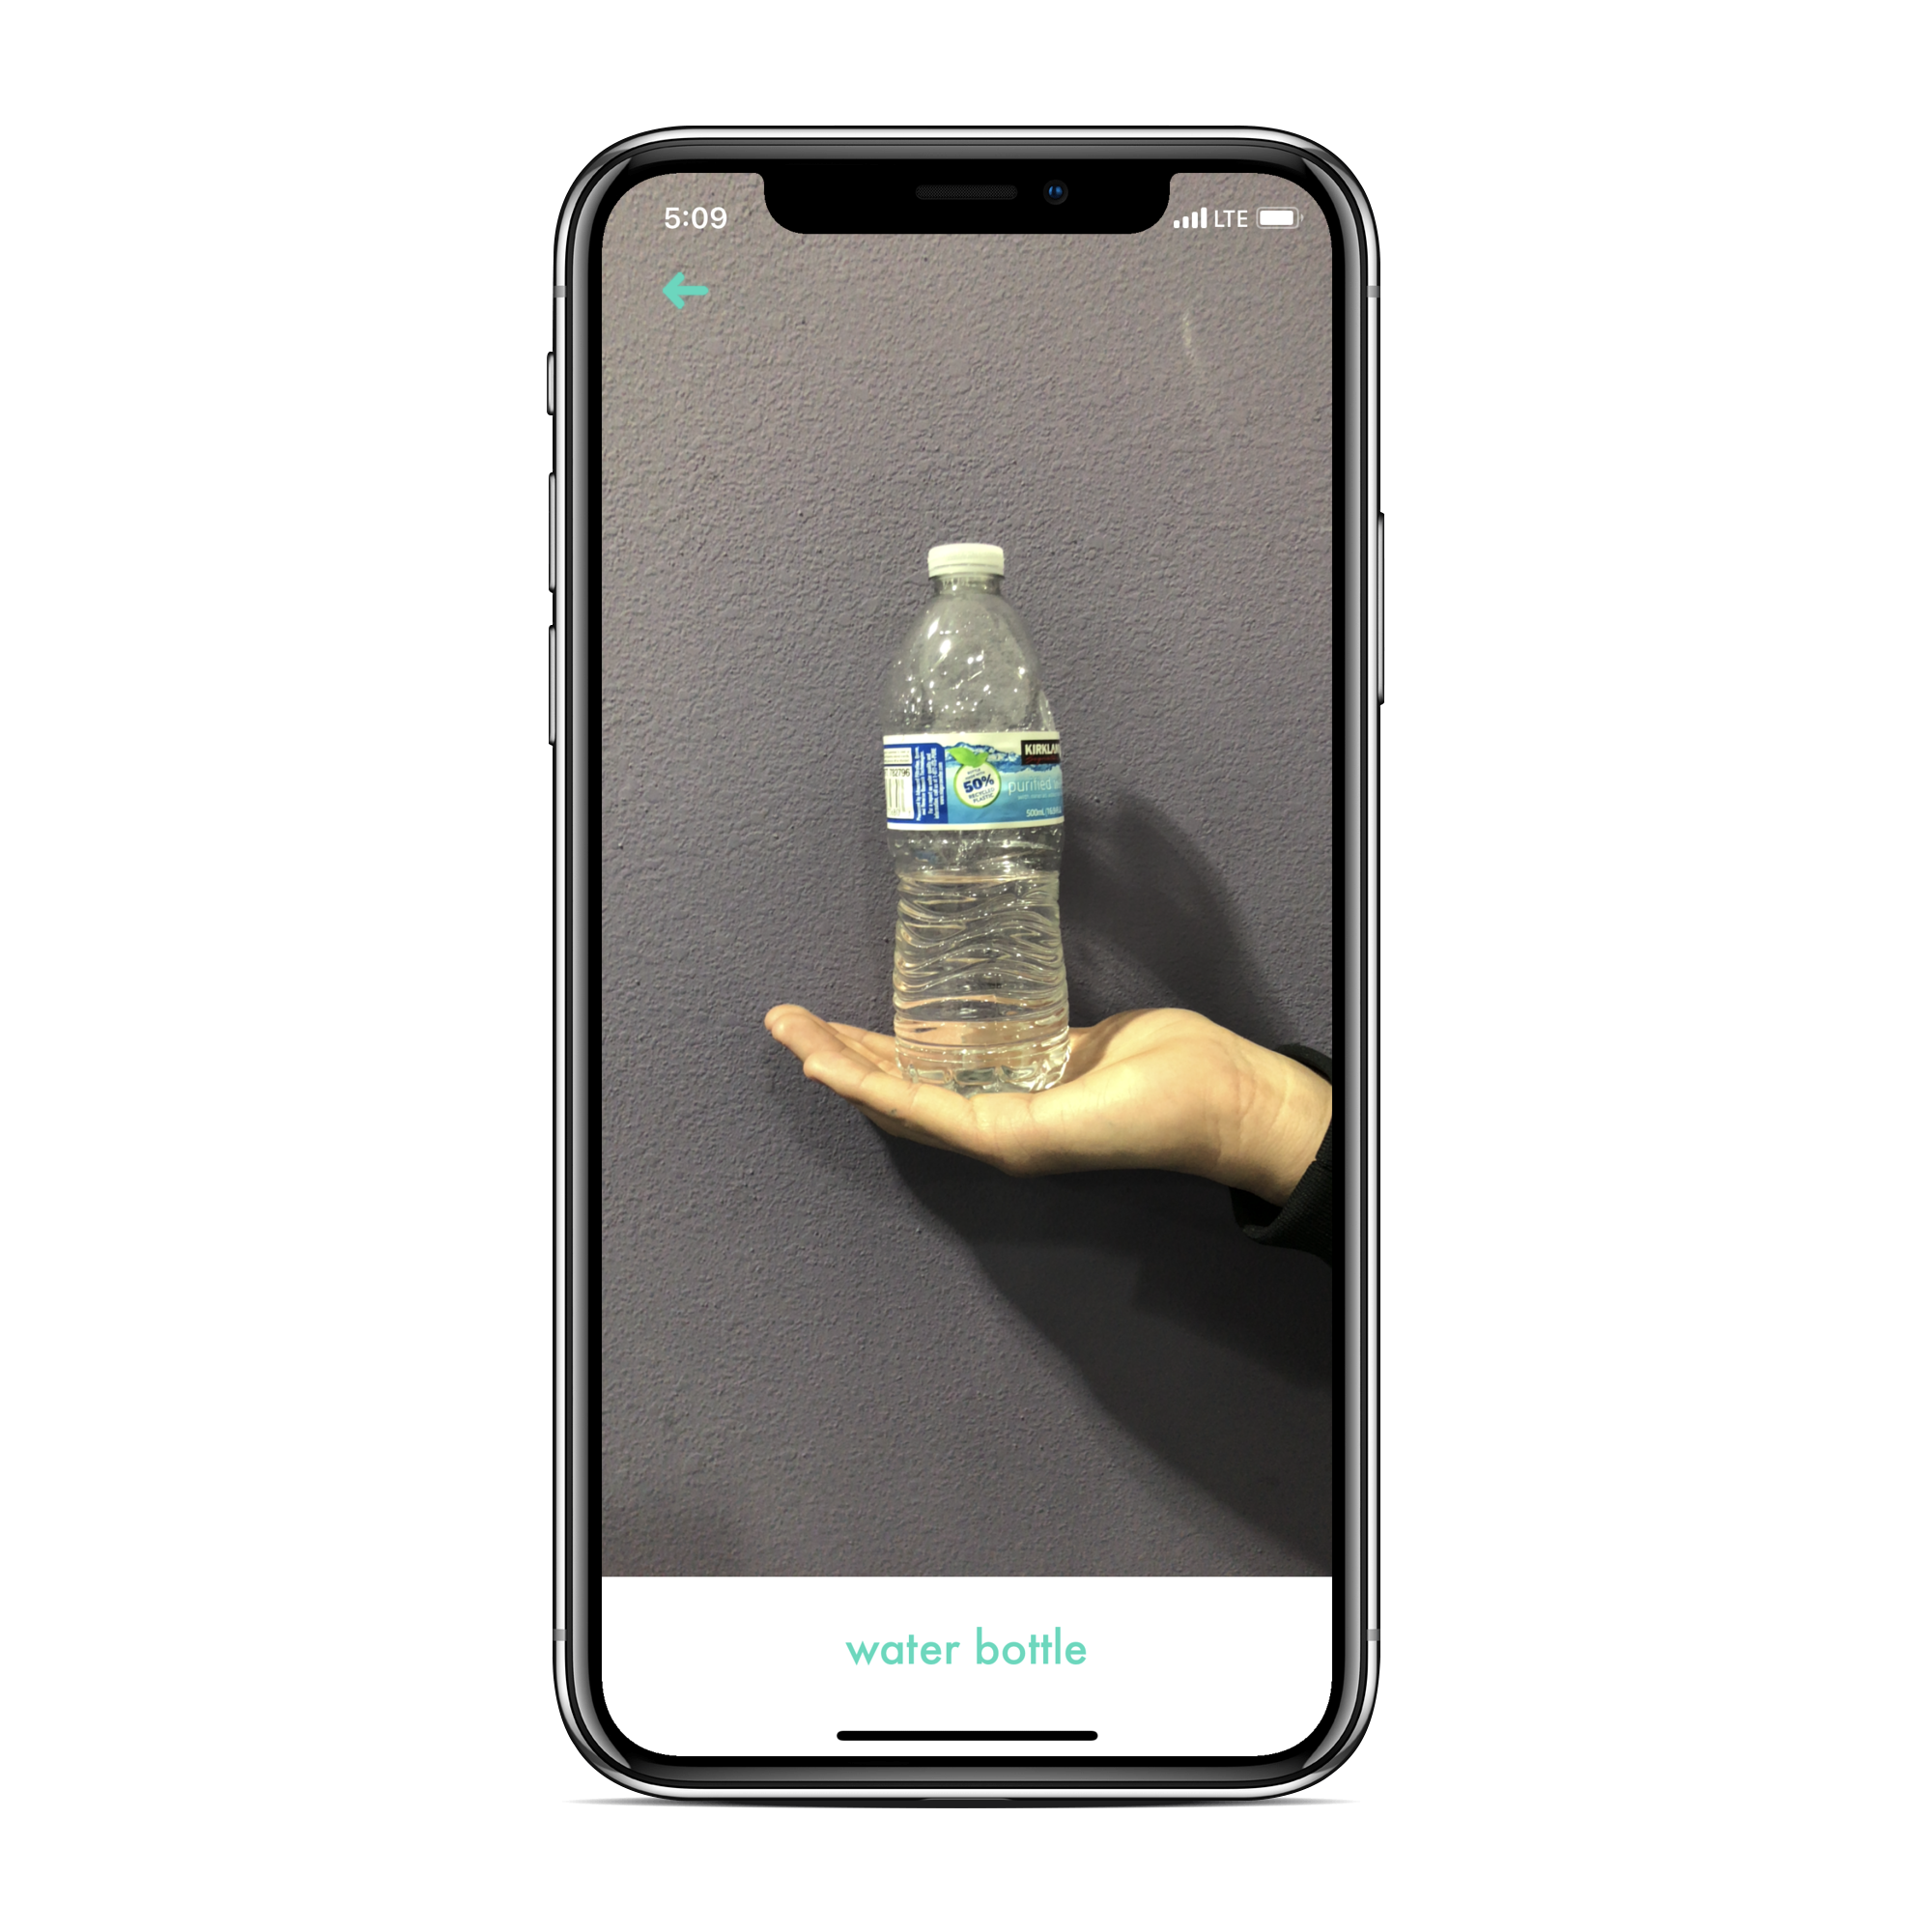
Wordy
Learn by Capturing

Slide 2
What Wordy Does
Wordy uses Machine Learning model to classify objects in real time. Even Offline.

Slide 3

Other features
Wordy translates the detected objects from the camera into nine different languages including Chinese, French, Spanish, and German

Slide 4
Demo

Slide 5
Want to Learn More?
Come visit us at https://brando-commando.github.io/Wordy/
Coming to the App Store late 2018

